Slide 1


Eco-Cart+: Sustainable E-commerce Platform
Role-based sustainability evaluation for eco-conscious commerce
by Mycline Shareena

Slide 2

Current E-commerce Challenges
Sustainability Oversight
Transparency Gap
Missing Accountability
Buyers lack product environmental information
No platform holds sellers responsible
Platforms ignore environmental impact

Slide 3
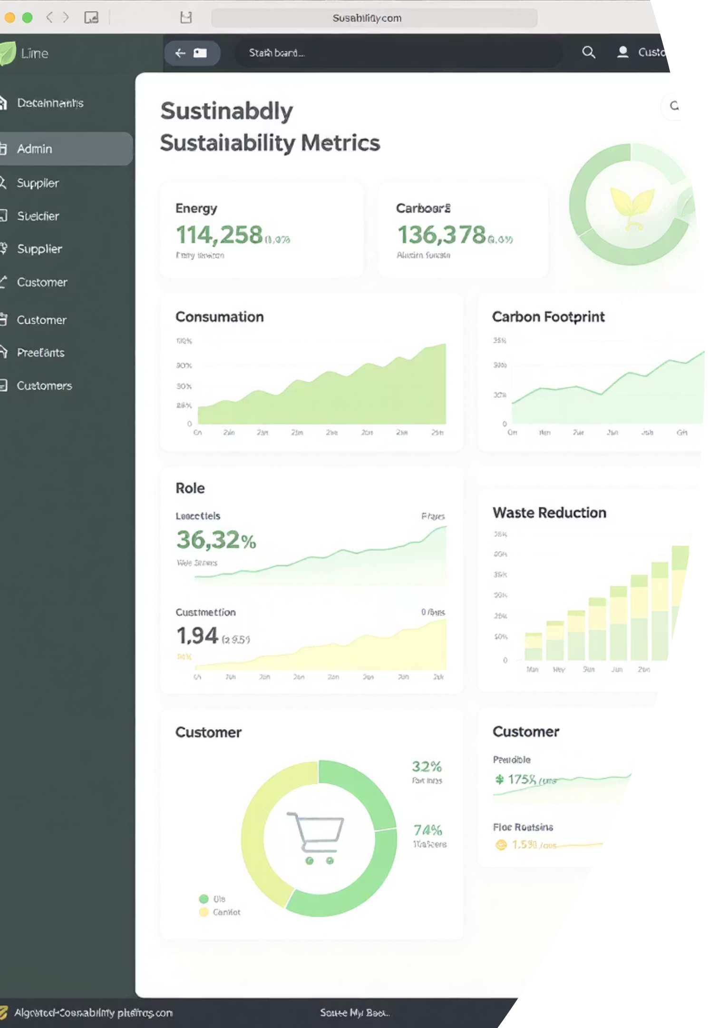



Our Solution: Eco-Cart+
Eco-Score Certification
Carbon Tracking
Verified ratings by external auditors
Real-time delivery emissions calculation
Role-Specific Dashboards
Specialized workspaces for stakeholders

Slide 4




System Architecture Overview
Network
1
Eco-Cart+ Marketplace
4 Enterprises
2
Seller, Shipping, Eco-Certification, Support
6 Organizations
3
Product, Order, Shipping, Financial, Auditing, Support
8+ Unique Roles
4
Admin, Seller, Buyer, Auditors, Coordinators

Slide 5
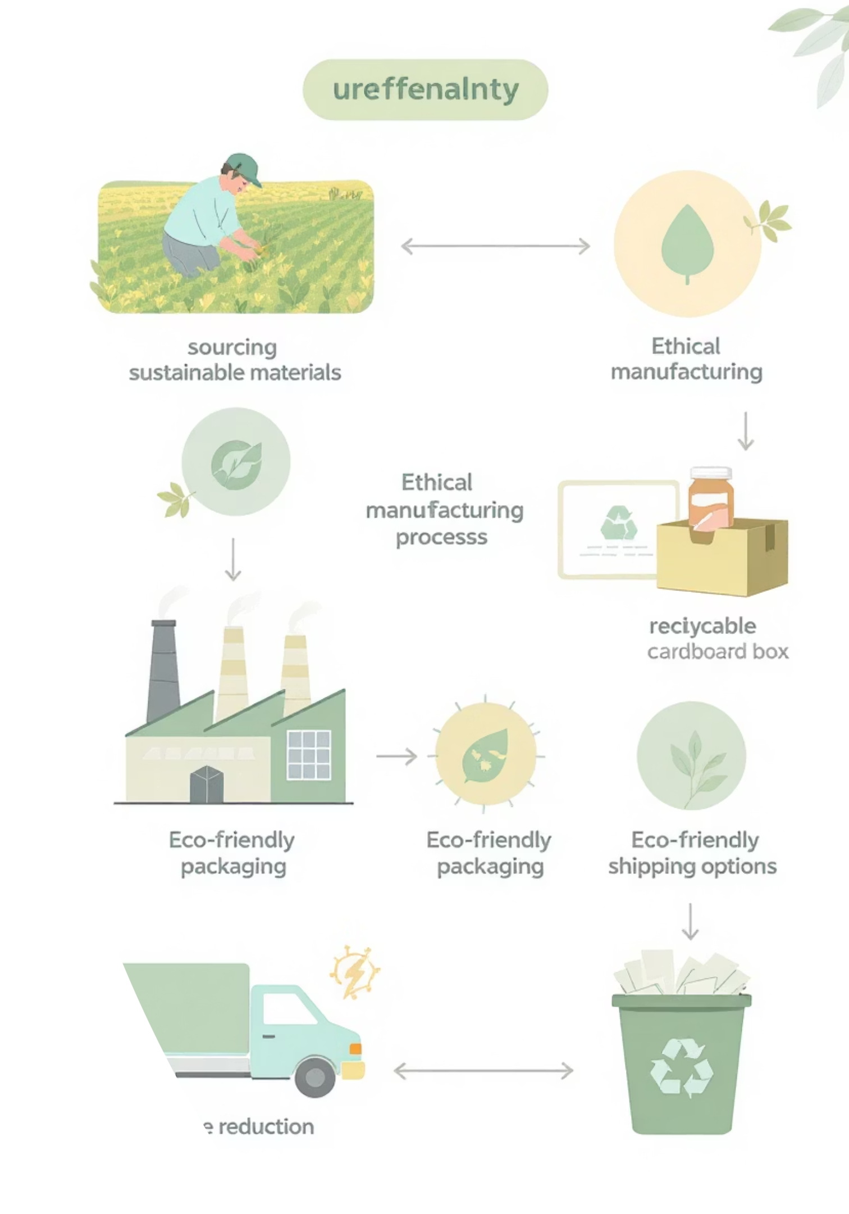



Core Use Cases & Workflows
Product Certification
Seller → Eco-Certification → Approval
Order Fulfillment
Seller → Shipping → Support
Sustainability Audit
Product → Eco Auditing → Financial

Slide 6
Advanced Features & Innovation
Technical Excellence
Sustainability Features
MongoDB integration
Carbon footprint calculator
Role-based authentication
Multi-criteria assessment
Real-time updates
Transparency dashboard

Slide 7








System Impact & Value
Environmental
Business
Carbon transparency
Sustainability as advantage
Logistics
Stakeholders
Eco-friendly delivery networks
Informed purchasing decisions

Slide 8
Project Achievements & Future
Requirements Fulfilled
Future Enhancements
4 Enterprises
AI recommendations
6 Organizations
Blockchain integration
8+ Unique Roles
Mobile application
4+ Work Requests
Carbon offset features

